Slide 1


Horizon 2025
“Unleashing Student Potential”
School Board Retreat Follow-Up
Strategic Plan Board Goal(s) & Priorities
June 27, 2013

Slide 2

Alignment
Strategic Planning Process
Vision
Mission
Values
Goals
Plan
Do
Study
Act
School Board (Formation)
June
Our Focus
Division Priorities
Superintendent
Division Strategies and KPIs
Division Leaders
(Implementation)
July/August/September
School Improvement Plans
Department Improvement Plans
PLC Plans
Individual Goal Setting

Slide 3

Our Board Priorities…
establish the focus for Division strategies and action plans
support attainment of our main goal
guide key decision-making processes including the allocation of resources
should help in closing the gap between current state and desired state

Slide 4
At the retreat, we proposed moving from our current model…
Goal 1
Goal 2
Goal 3
Goal 4
Goal 5
Priority
Priority
Priority
Priority
Priority
Priority
Priority

Slide 5
…to one student-centered SMART goal
One Student-Centered SMART Goal
By 2025, 97 % or more of students will graduate having mastered the lifelong-learning skills they need to succeed as 21st century learners, workers, and citizens.
Objective 1
We will engage every student
Objective 2 We will implement balanced assessments
Objective 3 We will improve opportunity and achievement
Objective 4 We will create and expand partnerships
Objective 5 We will optimize resources
Our Objectives
Our Commitments for How We Intend to Achieve Our Goal

Slide 6
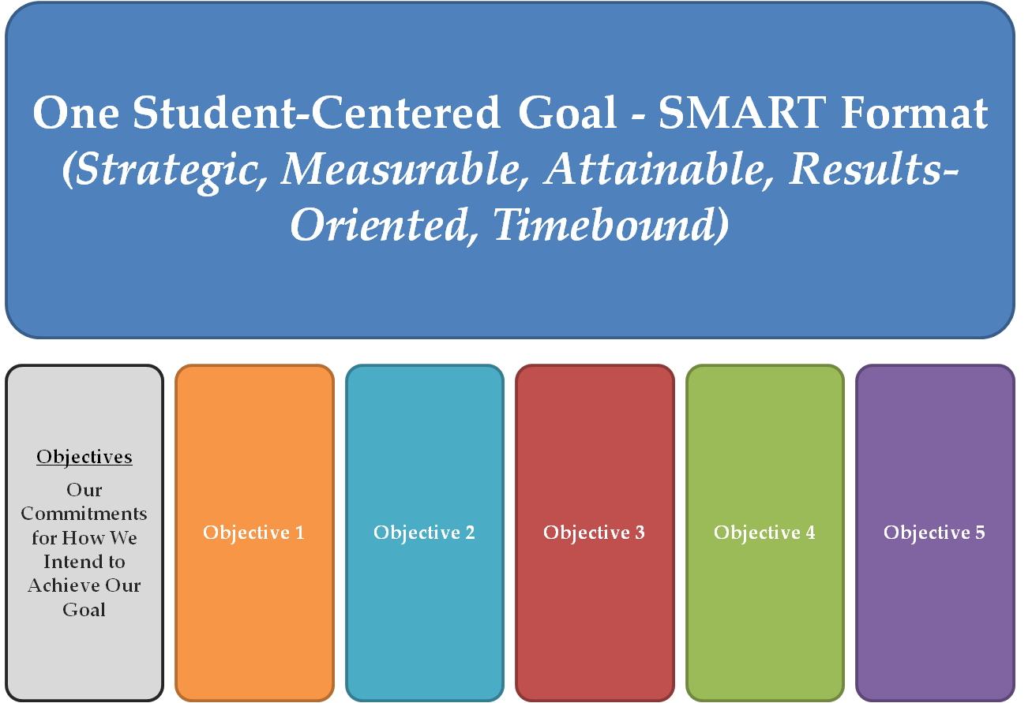
We propose measuring the goal using one baseline measure and a set of quality assurance indicators
Baseline Measure
and
Quality Assurance Indicators

Slide 7
Our Baseline Goal Measure
On-time graduation rate for a given class and enrollment groups (includes all diploma types, GEDs, and Certificates of Completion)

Slide 8
Our Quality Assurance Indicators…
K-12 Performance Tasks
On-Grade Reading Level (New!)
Advanced Studies Diplomas
Industry Certifications
Arts, Extra-Curriculars, Sports
Mentorships and Internships
Volunteer Activities
CWRA
College Retention Rate
ACPS Seal?

Slide 9
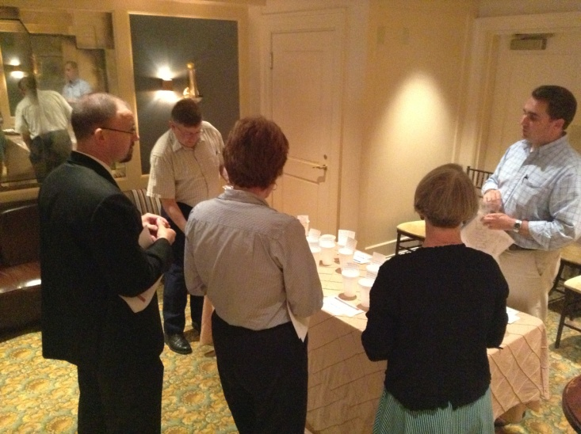
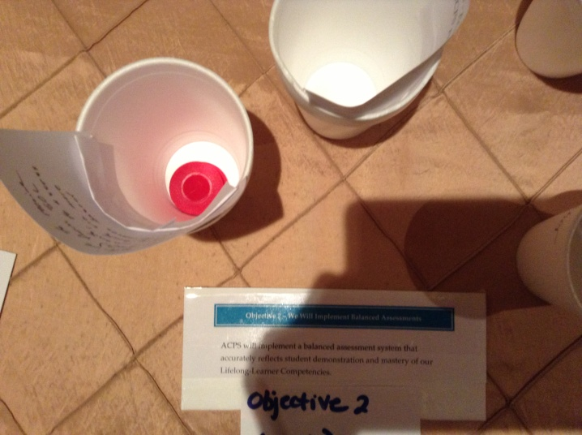
At the Retreat, Board members narrowed the list of potential Priorities.
Red = Consensus
Blue = 3 or More
White = 1 Individual

Slide 10
Objective 1 – We Will Engage Every Student
“All teachers and schools will engage every student in meaningful, authentic and rigorous work through the use of instructional best practices and supportive technologies that will motivate students to be self-directed and inquisitive lifelong-learners. “
Board Suggestions for Priorities
Define, develop, and implement effective teaching practices that maximize rigor and meaningful engagement for all students AND expand PD for teachers and administrators…(5R)
Integrate supportive technologies and the use of contemporary learning spaces into the instructional program delivery (4B)

Slide 11
Objective 2 – We Will Implement Balanced Assessments
“ACPS will implement a balanced assessment system that accurately reflects student demonstration and mastery of our Lifelong-Learner Competencies. “
Board Suggestions for Priorities
Other: Develop ACPS graduation seal to reflect division graduation requirements (5R)
Other: Board will strive to receive State waiver(s) from SOL testing requirements, to assess Albemarle students via more rigorous, performance-based assessments (5R)

Slide 12
Objective 3 – We Will Improve Opportunity and Achievement
“ACPS will improve lifelong-learning opportunity and achievement for all students and enrollment groups.“
Board Suggestions for Priorities
Measure and report student performance on key metrics for work and college readiness from K through high school AND monitor and report student performance on ACPS division-wide performance task assessments (5B)

Slide 13
Objective 4 – We Will Create and Expand Partnerships
“ACPS will create and expand partnerships with parents, community and business leaders to fulfill their essential roles as actively engaged partners in supporting student achievement and lifelong-learning outcomes for student success “
Board Suggestions for Priorities
Implement a comprehensive mentorship and internship program throughout the school division (5W)
Use strategic communications to invest the full community in supporting student achievement and outcomes for student success (2W)

Slide 14
Objective 5 – We Will Optimize Resources
“ACPS will optimize all resources to achieve the school division’s strategic goal and outcomes for student success“
Board Suggestions for Priorities
Other: Obtain funding from Board of Supervisors and/or community to support Board priorities and Horizon 2020 strategic plan – World Languages Program (4B)
Ensure health and safety of the school community (2W)

Slide 15
Breakout Sessions
Purpose: Adopt 1-2 major focus areas (Priorities) for each Objective that will serve as the foundation for Strategies and KPIs.
Group 1 (Goal Indicators & Obj. 1)
Goal Quality Indicators
We Will Engage Every Student
Group 2 (Obj. 2 & 3)
We Will Implement Balanced Assessments
We Will Improve Opportunity and Achievement
Group 3 (Obj. 4 & 5)
We Will Create and Expand Partnerships
We Will Optimize Resources

Slide 16
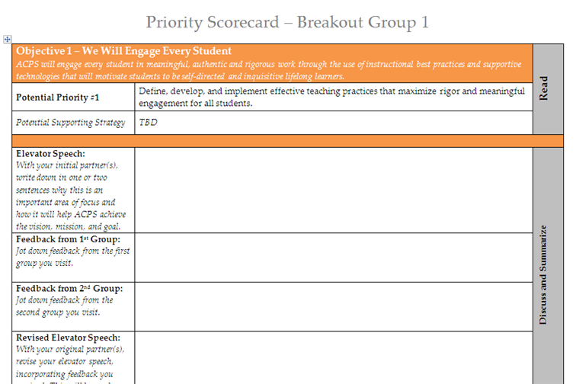
Breakout Sessions
STEP 1: Teams of Board Members will initially work together in groups of 2-3 on specific Priorities (30 minutes).

Slide 17
Breakout Sessions
STEP 1: Teams of Board Members will initially work together in groups of 2-3 on specific Priorities (30 minutes).
Group 1
Group 2
Group 3

Slide 18
Breakout Sessions
STEP 2: 1 member of each group rotate and 1 remain. Share your group’s work with the new group to get feedback (10 minutes)
STEP 3: Repeat with next group (10 minutes)
Group 1
Group 2
Group 3

Slide 19
Breakout Sessions
STEP 4: Return to original groups to share feedback you received (10 minutes) before reconvening and reporting out to the entire Board.
Group 1
Group 2
Group 3

Slide 20

Breakout Sessions
Purpose: Decide on 1-2 major focus areas (Priorities) for each Objective that will serve as the foundation for Strategies and KPIs.
Divide into 3 groups of 2 or 3 Board Members
30 Minutes - Work with your partner(s) to complete the Priority Scorecard and “Elevator Speech” for each of your potential priorities
10 Minutes - 1 member of each group rotate and 1 remain. Share your group’s work with the new group and refine your Priority Scorecards based on feedback
10 Minutes – Rotate again and repeat with next group
10 Minutes - Return to your original group and report what you heard from other members
40 Minutes - Reconvene as a Board and each group report out to finalize priority focus areas.

Slide 21

Next Steps:
July 25, 2013 – Joint Boards Meeting
  Update to BOS
July/August – Organizational Alignment
  Leaders align School and Department Improvement Plans , strategies, and KPIs
  Update internal tools, resources, processes
July/August – Communications Campaign
  Web site and social media
  Leadership speaking kits
  School posters
  Employee communications
  Parent communications
  Advisory groups
  Media and PSAs
  Back-to-School meetings

